Slide 1
Predicting Preterm Birth using cfRNA
Jason Lin, Jonathan Marin, John Santerre PhD

Slide 2
Introduction
Preterm birth is the leading cause of death in infants
15 million babies are born prematurely before 37 weeks every year
Rates of preterm birth range from 5% to 18% across 184 countries
"Preterm Birth." World Health Organization. February 19, 2018. Accessed July 07, 2019. https://www.who.int/news-room/fact-sheets/detail/preterm-birth
Notes:
Preterm birth is defined as birth before 37 weeks of gestation age. According to the World Health Organization, preterm birth is the leading cause of death in infants where 15 million babies are born prematurely every year.

Slide 3
Healthcare Problem
Modern medicine currently has no definitive indication for preterm birth
Measures can be taken to possibly prevent preterm birth if an early indication existed
Currently the health industry lacks insight in preterm birth related to gene expression
Kaplan, Oskovi, Ozgu-Erdinc Zeynep Asli, and A. Seval. "Prediction of Preterm Birth: Maternal Characteristics, Ultrasound Markers, and Biomarkers: An Updated Overview." Journal of Pregnancy. October 10, 2018. Accessed July 07, 2019. https://www.hindawi.com/journals/jp/2018/8367571/
Notes:
Their currently isn’t any test or indicator other than previous history that a women may deliver preterm birth. With early indication, measures can be taken to prolong spontaneous birth such as bedrest, a cerclage, or progesterone if doctors knew what to look for.

Slide 4
Study History
Data obtained from a Stanford University published study
Stanford University conducted the study heavier on statistical tests rather than data science techniques
Stanford University concluded with an AUC of 81% in predicting preterm birth
Digitale, Erin. "Blood Test for Pregnant Women Can Predict Premature Birth, Stanford-led Study Reports." News Center. June 7, 2018. Accessed July 07, 2019. https://med.stanford.edu/news/all-news/2018/06/blood-test-for-pregnant-women-can-predict-premature-birth.html.
Ngo, Thuy T. M., Marie-Louise H. Rasmussen Mira N. Moufarrej, Joan Camunas-Soler, Wenying Pan, Jennifer Okamoto, Norma F. Neff, Keli Liu, Ronald J. Wong, Katheryne Downes, Robert Tibshirani, Gary M. Shaw, David K. Stevenson, Joseph R. Biggio, Michal A. Elovitz, Mads Melbye, and Stephen R. Quake. "Noninvasive Blood Tests for Fetal Development Predict Gestational Age and Preterm Delivery." Science. June 08, 2018. Accessed July 07, 2019. https://science.sciencemag.org/content/360/6393/1133.
Notes:
Stanford University conducted this study sponsored by March of Dimes, Bill and Melinda Gates Foundation, and the Chan Zuckerberg Foundation in which Chan Zuckerberg filed a patent for Stanford’s results and technology.

Slide 5
Study History
Data obtained from a Stanford University published study
Stanford University conducted the study heavier on statistical tests rather than data science techniques
Stanford University concluded with an AUC of 81% in predicting preterm birth
Digitale, Erin. "Blood Test for Pregnant Women Can Predict Premature Birth, Stanford-led Study Reports." News Center. June 7, 2018. Accessed July 07, 2019. https://med.stanford.edu/news/all-news/2018/06/blood-test-for-pregnant-women-can-predict-premature-birth.html.
Ngo, Thuy T. M., Marie-Louise H. Rasmussen Mira N. Moufarrej, Joan Camunas-Soler, Wenying Pan, Jennifer Okamoto, Norma F. Neff, Keli Liu, Ronald J. Wong, Katheryne Downes, Robert Tibshirani, Gary M. Shaw, David K. Stevenson, Joseph R. Biggio, Michal A. Elovitz, Mads Melbye, and Stephen R. Quake. "Noninvasive Blood Tests for Fetal Development Predict Gestational Age and Preterm Delivery." Science. June 08, 2018. Accessed July 07, 2019. https://science.sciencemag.org/content/360/6393/1133.
Notes:
Dup Slide on purpose for more time!
Stanford mainly used Statistical techniques throughout the published study and we were able to recreate the results using their code. We wanted to see if we can improve AUC by using data science techniques.

Slide 6
Data
Non-invasive blood samples were taken for women who delivered full term and preterm
Two different types of data sets existed
There were two cohorts in the study
All women in both cohorts were African American
Ngo, Thuy T. M., Marie-Louise H. Rasmussen Mira N. Moufarrej, Joan Camunas-Soler, Wenying Pan, Jennifer Okamoto, Norma F. Neff, Keli Liu, Ronald J. Wong, Katheryne Downes, Robert Tibshirani, Gary M. Shaw, David K. Stevenson, Joseph R. Biggio, Michal A. Elovitz, Mads Melbye, and Stephen R. Quake. "Noninvasive Blood Tests for Fetal Development Predict Gestational Age and Preterm Delivery." Science. June 08, 2018. Accessed July 07, 2019. https://science.sciencemag.org/content/360/6393/1133.
Notes:
Non-invasive blood samples were taken from women who delivered full term and preterm at time of birth. The range of gestation age for the study

Slide 7
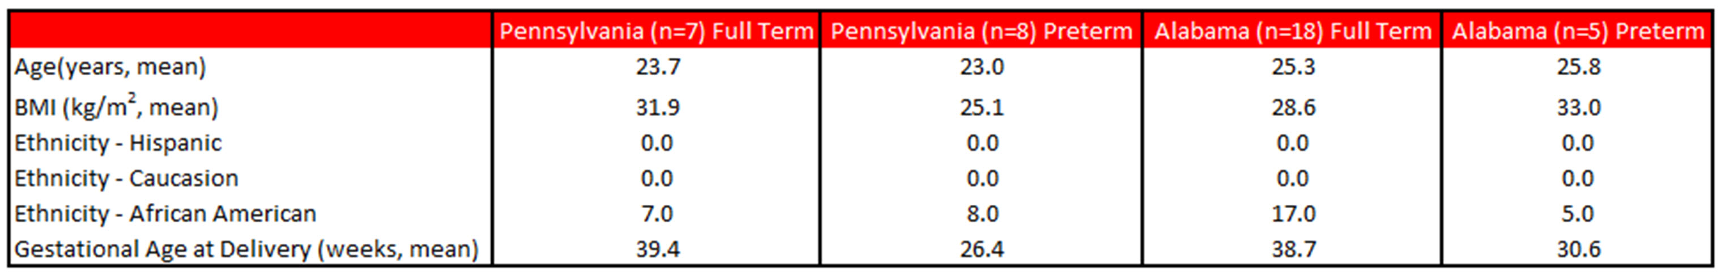
Data Cont. RNA Sequence Counts
Stanford University only used this data set for preterm prediction
Only the Pennsylvania cohort had RNA sequence count data
PA cohort contained only 7 full term women and 8 preterm women (15 sample size total)
Our best model was from this dataset

Slide 8
Data Cont. RNA Concentrations
Both Alabama and Pennsylvania had Gene Concentration data
This dataset was not used by Stanford Study
We dropped null columns and normalized the data to place it on same scale
Data set contained 25 full term women and 13 preterm women (sample size of 38)

Slide 9
Gene Selection
Extra Trees Classifier was used to reduce from ~50,000
Extra Trees Classifier was executed 100,000 times
Each iteration for gene selection was counted for weighting of most important genes

Slide 10
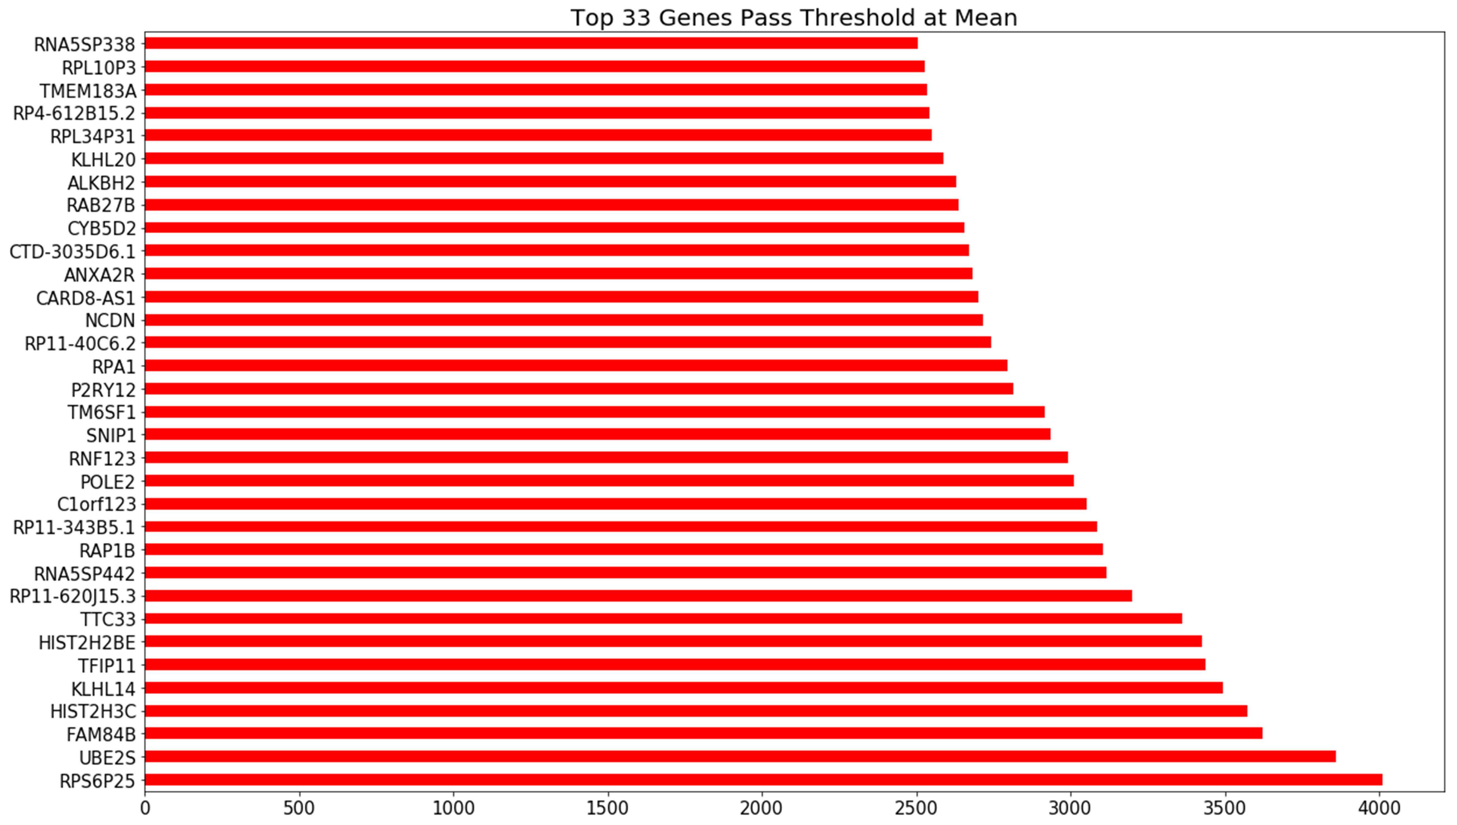
Gene Selection
Notes:
Extra Trees Classifier was used to reduce features from ~50,000 genes. We noticed that important features changed upon execution. So, we executed feature selection 100,000 times and counted the features for weighting of the most important genes for the study.

Slide 11
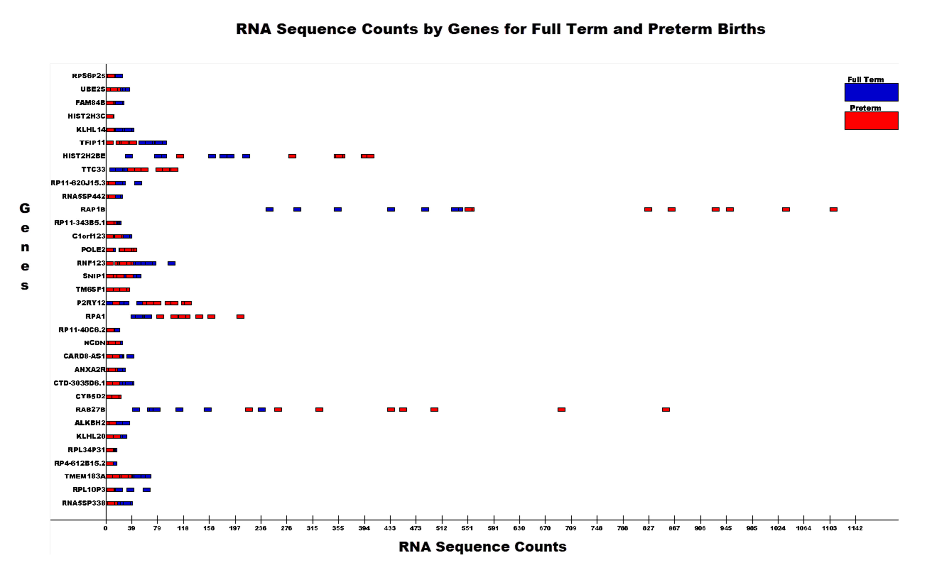
RNA Sequence Counts by Genes

Slide 12
Model Classification
To mitigate small sample size, stratified shuffle split was implemented with 20% test validation and 10 number of splits
To optimize AUC, area under curve, grid search was used to determine best model
The measurement of AUC is used to compare to the Stanford Study
Notes:
Higher the AUC, better the model is at predicting 0s as 0s and 1s as 1s. By analogy, Higher the AUC, better the model is at distinguishing between patients with disease and no disease.

Slide 13
Decision Tree Overview
It is a non-parametric model
A sequential list of questions leading to a given outcome
Measures are used to ensure “purity” of final outcome
However, can easily lead to overfitting
"1.10. Decision Trees." Scikit. Accessed July 07, 2019. https://scikit-learn.org/stable/modules/tree.html
Notes:
Meaning there is no need to understand the statistical distribution of the data
Measures of purity include Gini and Information Gain
Sometimes the model is so complex that it does not generalize well outside of training data

Slide 14
Decision Tree Results
RNA-Sequence Counts AUC = 70%
RNA- Concentration AUC = 80%
Stanford AUC = 81%
Notes:
The results clearly show that decision tree may have predictive power in the case of RNA Concentration data

Slide 15
KNN Overview
It is ALSO a non-parametric model
A random point is placed and a “vote” is taken by it’s K nearest neighbors
High accuracy relative to other supervised models
However, it is computationally expensive
"Sklearn.neighbors.KNeighborsClassifier." Scikit. Accessed July 07, 2019. https://scikit-learn.org/stable/modules/generated/sklearn.neighbors.KNeighborsClassifier.html.
Notes:
Same as decision tree, it does not require an assumption about the statistical distribution
The model algorithm is simple to use
KNN requires the use of all training data, and stores all the training data to the prediction

Slide 16
KNN Results
RNA-Sequence Counts AUC = 100%
RNA- Concentration AUC = 67%
Stanford AUC = 81%
Notes:
RNA-Sequence counts clearly has predictive power with the given features
It shows RNA Sequence counts data has potential to clearly differentiate preterm and full term birth.

Slide 17
Random Forest Overview
It is a collection of many decision trees
The collective vote of the decision trees is the outcome
However, must be low correlation between trees
"3.2.4.3.1. Sklearn.ensemble.RandomForestClassifier." Scikit. Accessed July 07, 2019. https://scikit-learn.org/stable/modules/generated/sklearn.ensemble.RandomForestClassifier.html.
Notes:
As the same as the other two mentioned models, it is a non-parametric model
Random forest is a ensemble method. A large number of relatively uncorrelated models (trees) operating as a committee will outperform any of the individual constituent models.
However, there must be low correlation because one tree may influence another tree’s decision.

Slide 18
Random Forest Results
RNA-Sequence Counts AUC = 100%
RNA- Concentration AUC = 77%
Stanford AUC = 81%
Notes:
RNA-Sequence counts clearly has predictive power with the given features
It shows RNA Sequence counts data has potential to clearly differentiate preterm and full term birth.

Slide 19
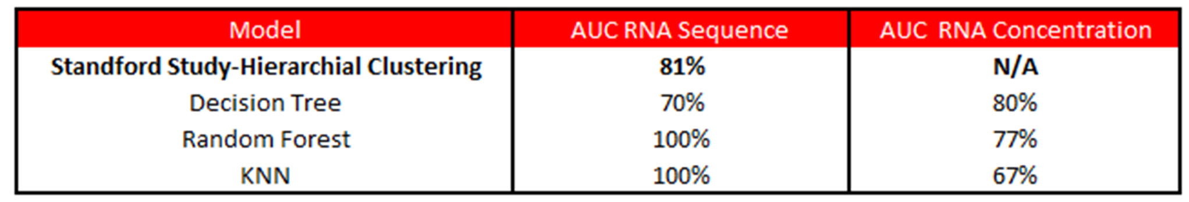
Results
Notes:
Overall, RNA sequence data is clearly more predictive with lower sample volume.
But with the higher sample data set, we were able to predict the same AUC as Stanford, which they did not use
Potentially the RNA concentration data set could be used for further study.

Slide 20
Conclusion
Machine learning increased AUC to 100% compared to the Stanford Study of 81%
The RNA concentration data set containing two cohorts was not as predictive as the RNA sequence count of one cohort.
A more diverse sample should be collected to confirm results

Slide 21
In Dedication to:
Sofia Adriana Marin
Marisa Diane Marin
Olivia Gene Marin
9/16/2013-9/16/2013

